Slide 1
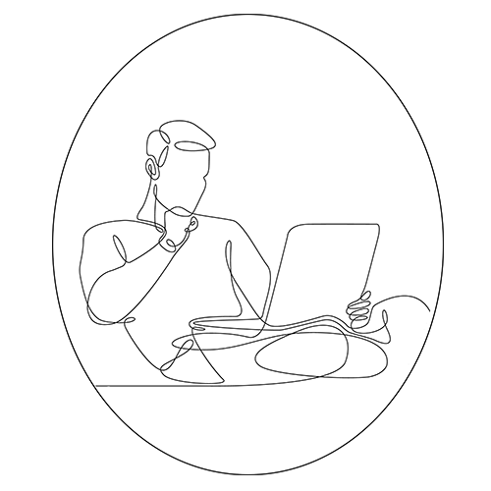
.Net MAUI – Multi-platform App UI The Journey to One .Net
Blog
https://russellgilbert.uk
Website
https://sandyatom.net
Russell Gilbert is Programmer 59

Slide 2
.Net MAUI – Multi-platform App UI The Journey to One .Net
Russell Gilbert is Programmer 59

Slide 3
.Net MAUI – Multi-platform App UI
Supported Platforms
Android
iOS
MacOS (including Apple Silicon – AKA M1)
Windows Desktop
Feature Parity
Russell Gilbert is Programmer 59

Slide 4
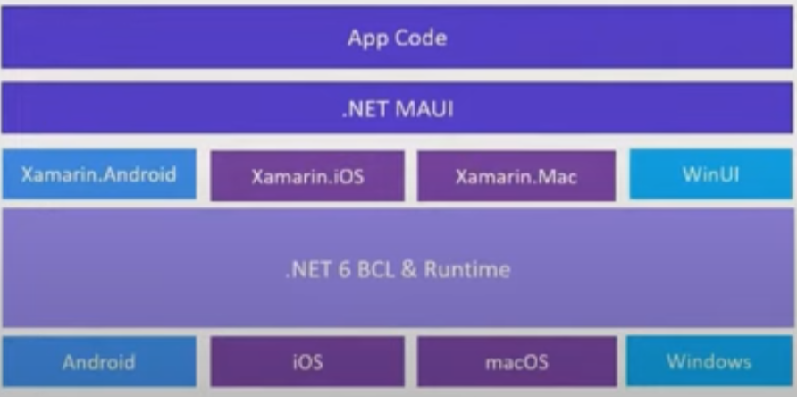
.Net MAUI – Multi-platform App UI
Russell Gilbert is Programmer 59

Slide 5
.Net MAUI – Multi-platform App UI
Run Jonathan Dick’s maui-check tool (Redth/dotnet-maui-check: .NET MAUI Check tool (github.com))
dotnet tool install –g Redth.Net.Maui.Check
Maui-check
Russell Gilbert is Programmer 59

Slide 6
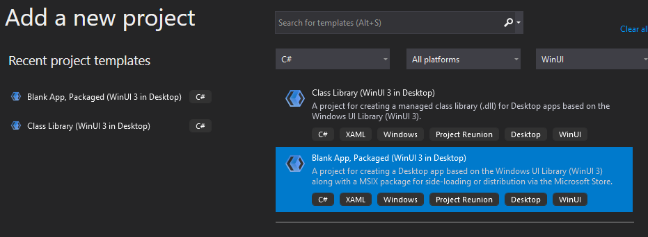
.Net MAUI – Multi-platform App UI
Windows Desktop Project
Install Project Reunion Extension to Visual Studio 2019 Preview
Create solution Folder
Add global.json to folder…
Create a Blank Solution
Add WinUI Desktop Project
Add framework reference to .csproj file
global.json
{
"sdk": {
"version": "5.0.202"
}
}
<ItemGroup>
<FrameworkReference Update="Microsoft.Windows.SDK.NET.Ref" RuntimeFrameworkVersion="10.0.18362.16" />
<FrameworkReference Update="Microsoft.Windows.SDK.NET.Ref" TargetingPackVersion="10.0.18362.16" />
</ItemGroup>
Russell Gilbert is Programmer 59

Slide 7
.Net MAUI – Multi-platform App UI
Useful Links
https://devblogs.microsoft.com/dotnet/announcing-net-6-preview-3/
https://devblogs.microsoft.com/dotnet/announcing-net-multi-platform-app-ui-preview-3/
https://github.com/dotnet/maui
https://docs.microsoft.com/en-us/windows/apps/project-reunion/get-started-with-project-reunion#set-up-your-development-environment
https://docs.microsoft.com/en-us/windows/apps/winui/winui3/winui-project-templates-in-visual-studio
(James Montemagno) https://www.youtube.com/watch?v=yxahL0xF3RU&t=632s
(David Ortinau) https://www.youtube.com/watch?v=qbHO8J3bId0
Russell Gilbert is Programmer 59

